Slide 1
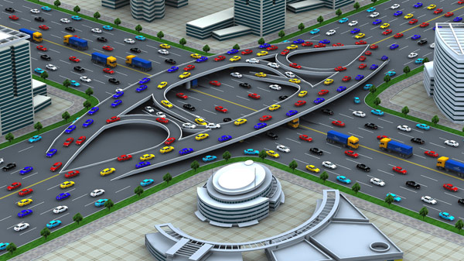
Traffic Engineering
University of Diyala
College of Engineering
Civil Engineering Department

Slide 2
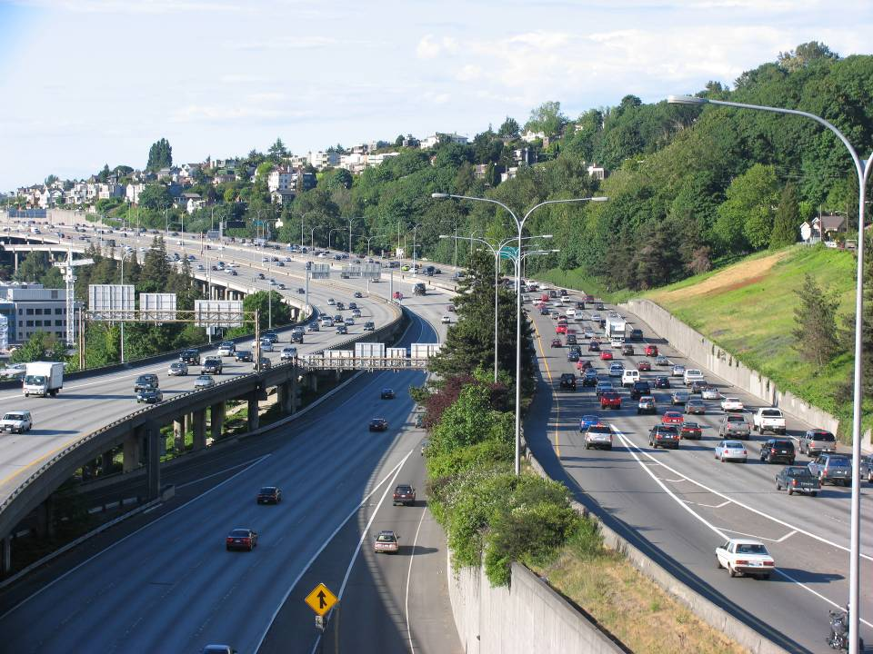
Freeway Capacity

Slide 3
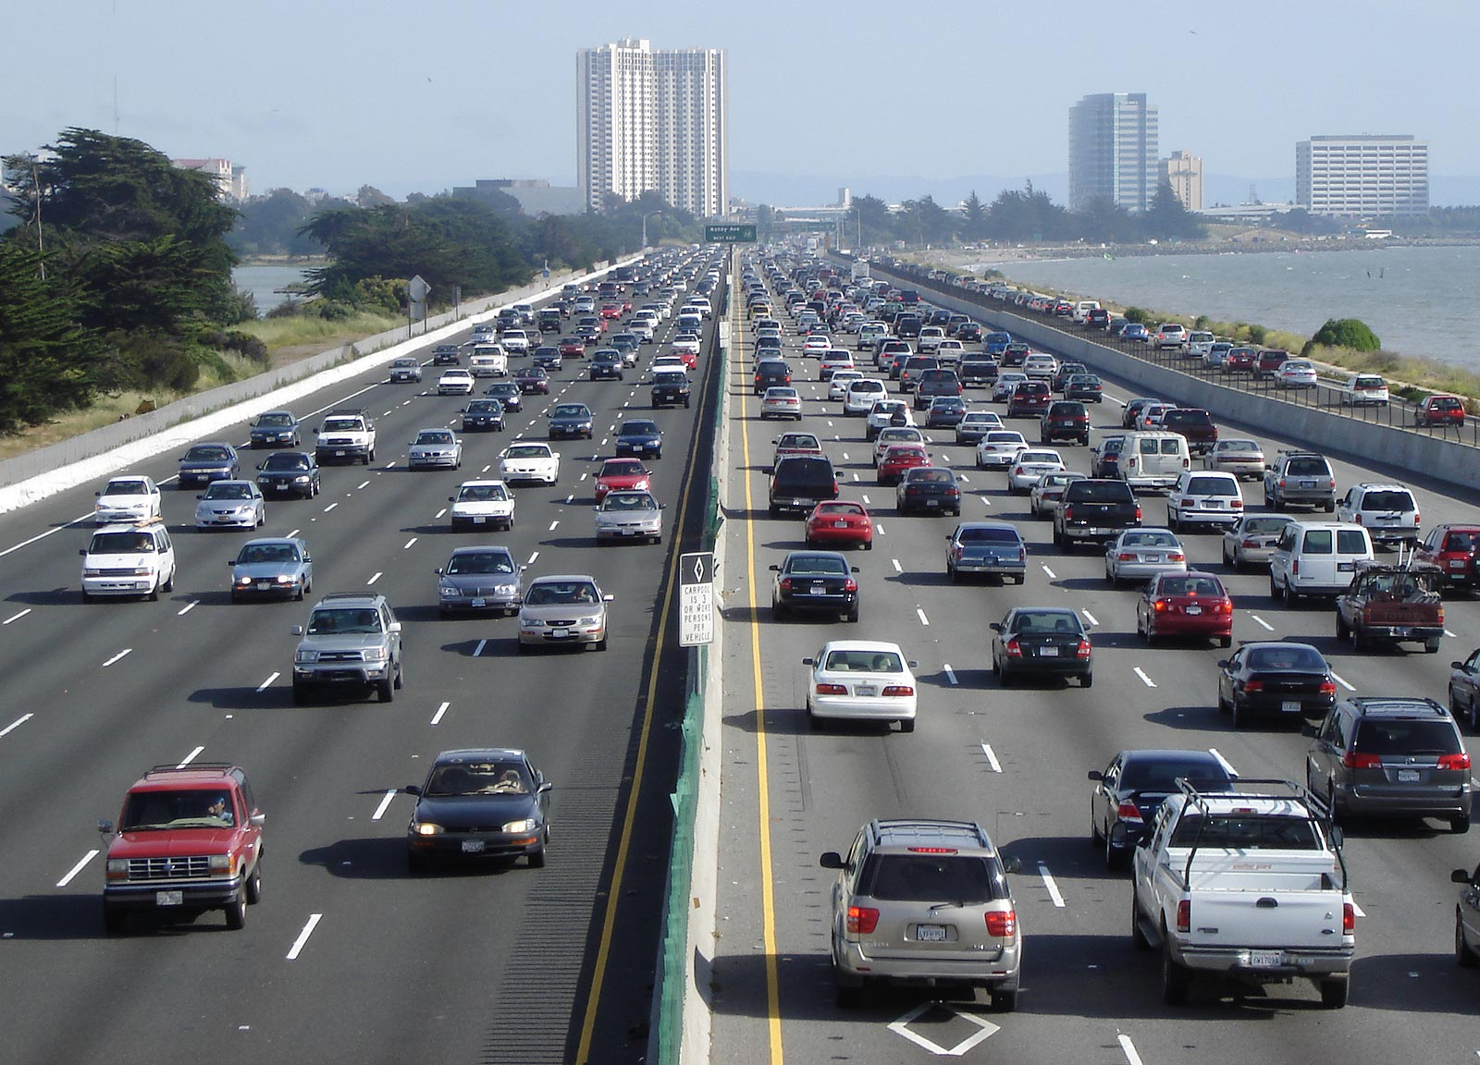
A freeway is a divided highway with full access control and two or more lanes in each direction for the exclusive use of moving traffic.

Slide 4
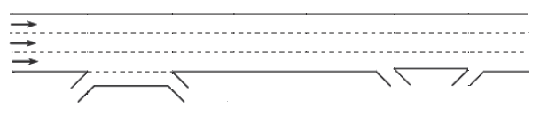
Freeway Facilities
2
1
3
A freeway is composed of three elements:
Basic freeway sections.
Weaving areas.
Ramp junctions.

Slide 5
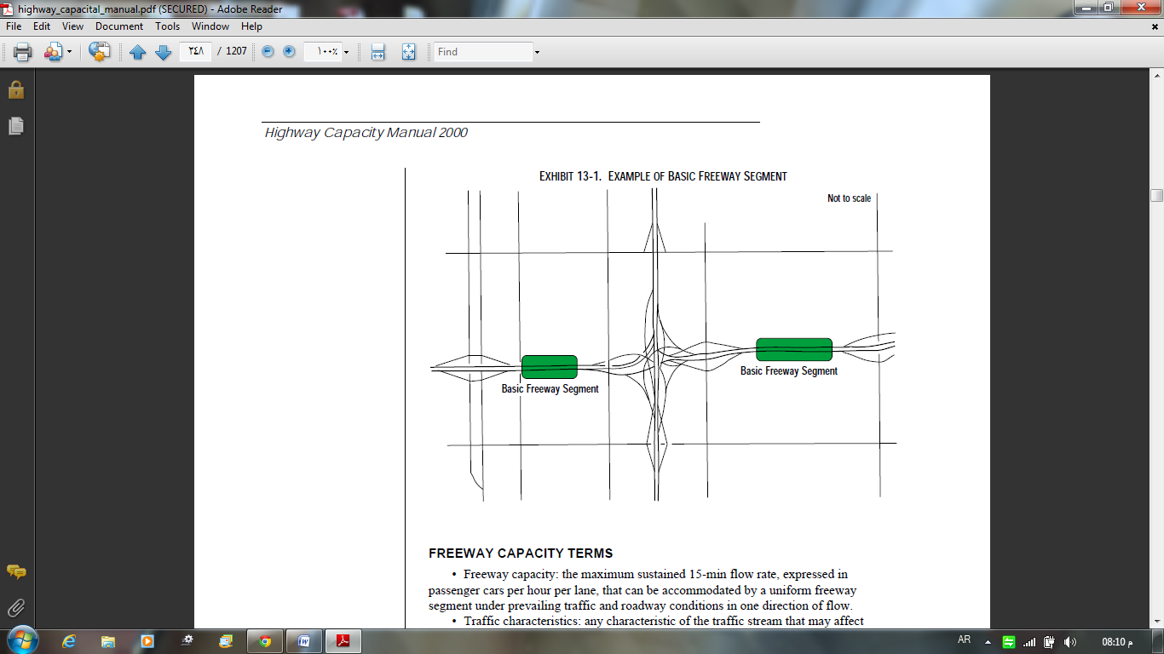
Basic Freeway Section
Basic freeway section: is outside of the influence area of ramps or weaving areas of the highway.

Slide 6
Basic Conditions
Lanes are 3.6 m wide
Lateral clearance between the edge of a right lane and an obstacle is 1.8m or greater
All passenger cars in the traffic stream
Urban freeways are five lanes in each direction
Interchanges spacing of 3 km or greater
Level terrain, with grades no greater than 2%
Driver population composed primarily of regular users of the facility

Slide 7
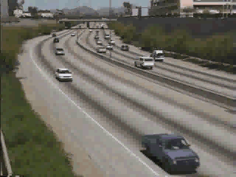
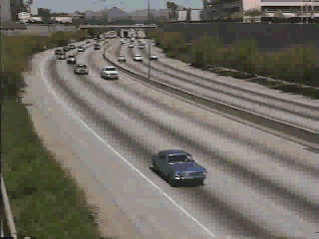
Level of Service
LOS A
  Free-flow operation
LOS B
  Reasonably free flow
  Ability to maneuver is only slightly restricted
  Effects of minor incidents still easily absorbed

Slide 8
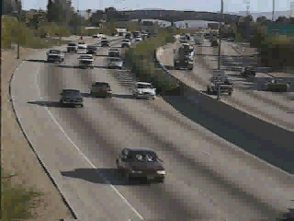
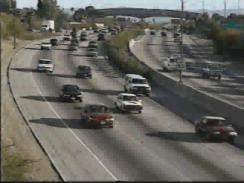
Level of Service
LOS C
  Speeds at or near FFS
  Freedom to maneuver is noticeably restricted
  Queues may form behind any significant blockage.
LOS D
  Speeds decline slightly with increasing flows
  Density increases more quickly
  Freedom to maneuver is more noticeably limited
  Minor incidents create queuing

Slide 9
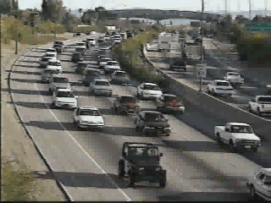
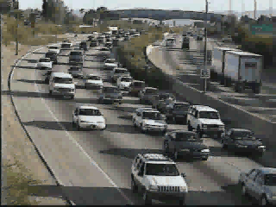
Level of Service
LOS E
  Operation near or at capacity
  No usable gaps in the traffic stream
  Operations extremely volatile
  Any disruption causes queuing
LOS F
  Breakdown in flow
  Queues form behind
  breakdown points
  Demand > capacity

Slide 11
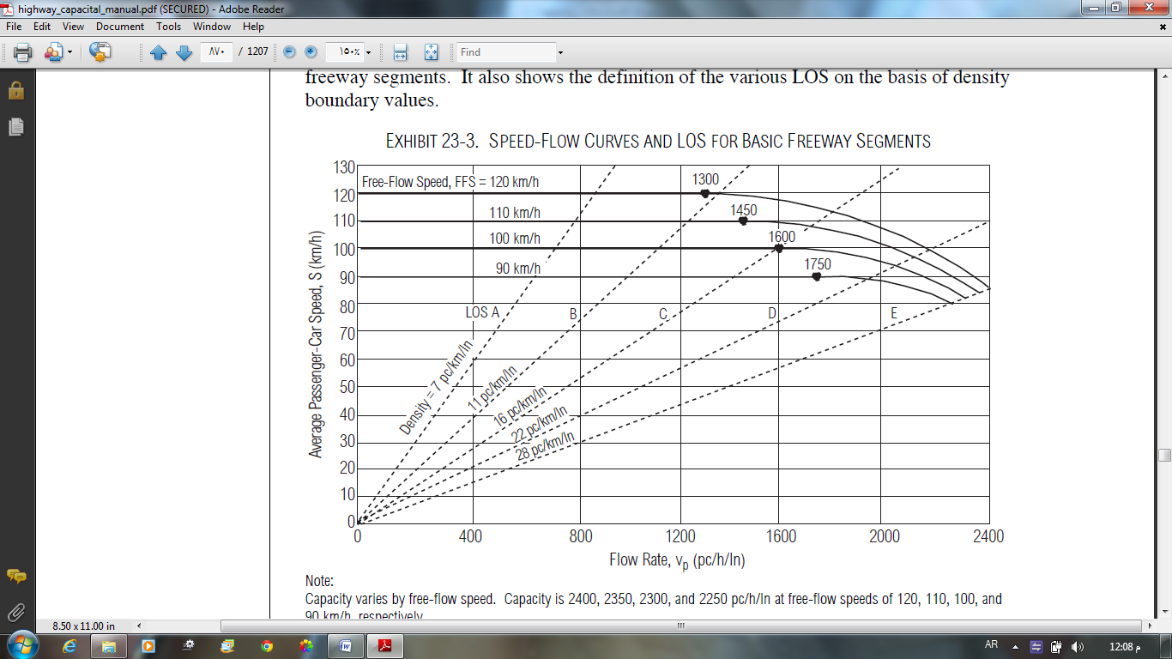
Calculating LOS

Slide 12
Determining Flow Rate
Adjust hourly volumes to get pc/ln/hr
Vp | = | 15-minute passenger-car equivalent flow rate
V | = | hourly volume (veh/hr)
PHF | = | peak hour factor
N | = | number of lanes in one direction
fHV | = | heavy-vehicle adjustment factor
fP | = | driver population adjustment factor (Urban=1.0 , Rural = 0.85)

Slide 13
Heavy Vehicle Adjustment (fHV)
PT: percent of trucks and buses
PR: percent of recreational vehicles
ET & ER: adjustment factors
(Table C.7)
(Table C.8)
(Table C.9)
(Table C.10)

Slide 14
Determining Free-flow Speed (FSS)
FFS | = | free-flow speed (km/hr)
BFFS | = | base free-flow speed, 1110 (urban), 20 (rural)
fLW | = | adjustment for lane width (km/hr)
fLC | = | adjustment for right-shoulder clearance (km/hr)
fN | = | adjustment for number of lanes (Km/hr)
fID | = | adjustment for interchange density (Km/hr)
(Table C.3)
(Table C.4)
(Table C.5)
(Table C.6)

Slide 15
Determine the Avg. Speed (S) and Density (D)
Using the flow rate (Vp) and free- flow speed (FFS) to calculate avg. speed (S) using
Then, calculate the Density
(Figure C.1)

Slide 16
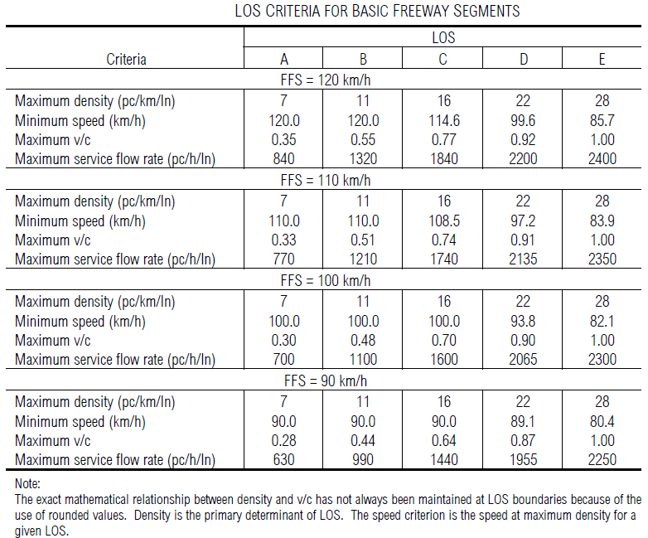
Determine LOS

Slide 17
Example-4
A six-lane urban freeway (3-lanes in each direction) is on rolling terrain with 3.6 m lanes, obstructions 0.6 m from the right edge of the traveled pavement, and 0.4 interchange per km. a directional weekday peak-hour volume of 2200 vehs is observed, with 700 vehs arriving in the most congested 15-min period. If the traffic stream has 15% large trucks and buses and no recreational vehs, determine LOS?

Slide 18
Example-5
A rural freeway has an ideal free-flow speed of 120 km/hr and two-lanes 3.6 m in each direction, with right shoulder lateral clearance of 1.2 m. Interchange are spaced approximately 5 km apart. Traffic consists of 10% trucks & buses and 8% recreational vehs. If the maximum 15-min flow rate is 1760 veh/hr, what is the level of service on a 1.7 km long 3.1% upgrade?

Slide 19
H.W-2
An urban freeway has four 3.5 m lanes in one direction and a traffic stream composed of 10 percent trucks and buses (recreational vehicles are negligible). The peak hour factor is 0.92. There are no lateral obstructions. Base free-flow speed is 110 km/hr. Interchange density is 0.63 per one km. What is the maximum hourly volume at level of service D on a 3 percent upgrade, 2 km long?

Slide 22
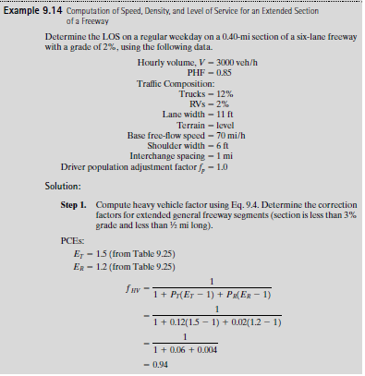

Slide 24
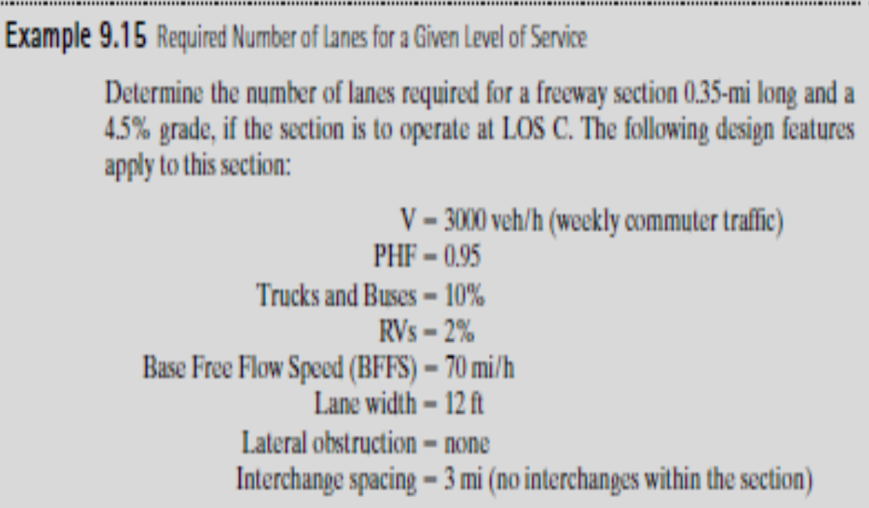

Slide 27


